Slide 1
Lecture
CNN introduction, Max pooling and others, CNN case study

Slide 2

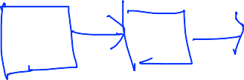

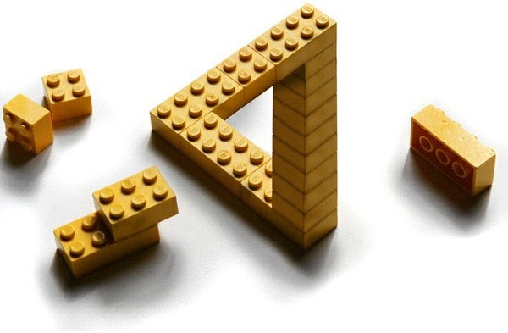
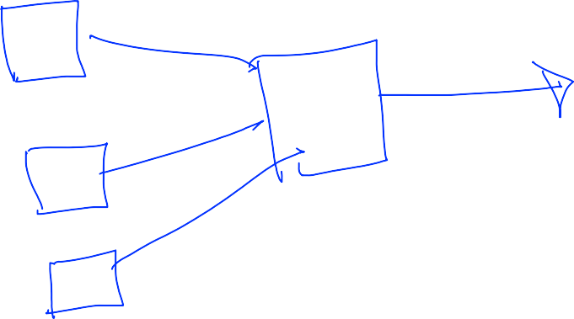


'The only limit is your imagination'
Notes:
Forward Net(Fully Connected) 뿐 아니라. 입력을 여러 개로 나눠서 나중에 합치면 형태도 생각 할 수 있음

Slide 3
Lecture 7:
Convolutional Neural Networks
http://cs231n.stanford.edu/
Fei-Fei Li & Andrej Karpathy & Justin Johnson
Lecture 7 -
1
27 Jan 2016
Fei-Fei Li & Andrej Karpathy & Justin Johnson Lecture 7 - 27 Jan 2016

Slide 4
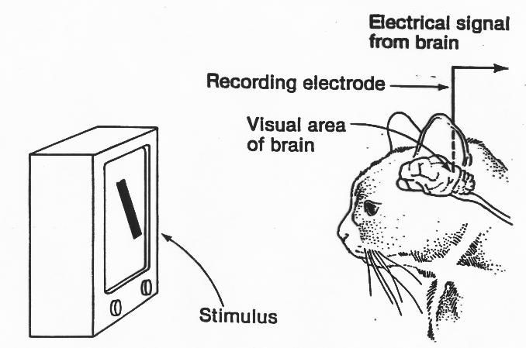
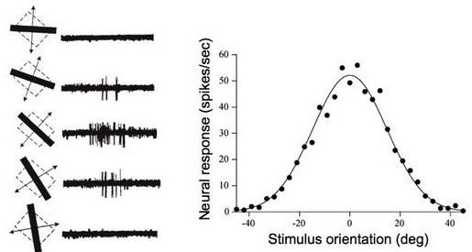
A bit of history:
Hubel & Wiesel, 1959
RECEPTIVE FIELDS OF SINGLE NEURONES IN
THE CAT'S STRIATE CORTEX
1962
RECEPTIVE FIELDS, BINOCULAR INTERACTION
AND FUNCTIONAL ARCHITECTURE IN
THE CAT'S VISUAL CORTEX
1968...
Fei-Fei Li & Andrej Karpathy & Justin Johnson
Lecture 7 -
7
27 Jan 2016
Fei-Fei Li & Andrej Karpathy & Justin Johnson Lecture 7 - 27 Jan 2016
Notes:
고양이가 그림을 볼 때 뉴런들이 부분부분 반응 한다는 걸 알게 됨
입력을 나눠 받는 거에서 착안함

Slide 5
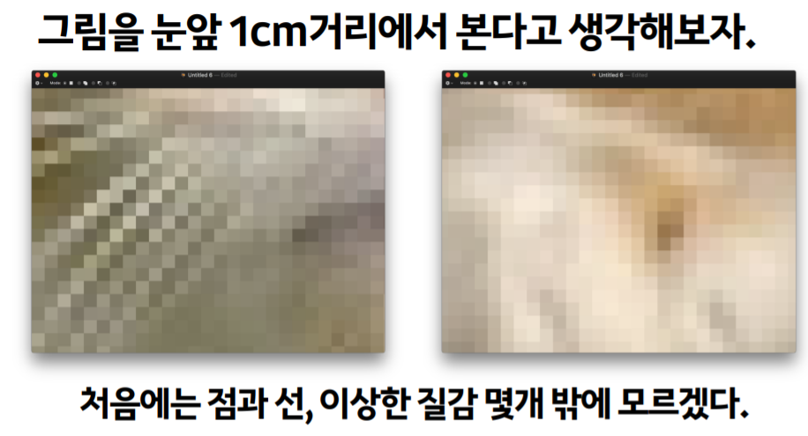

Slide 6
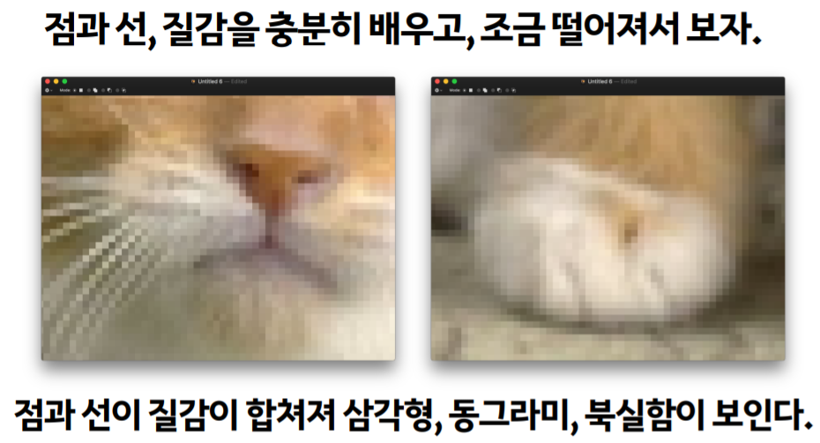

Slide 7
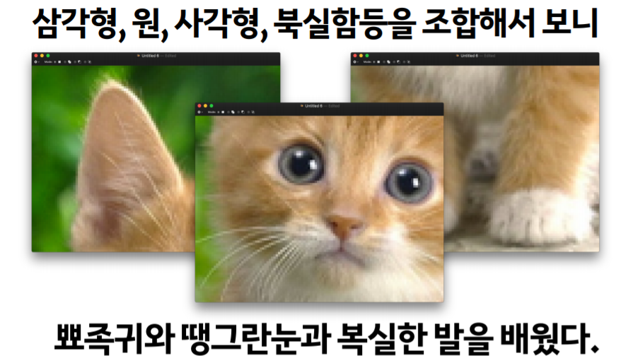

Slide 8
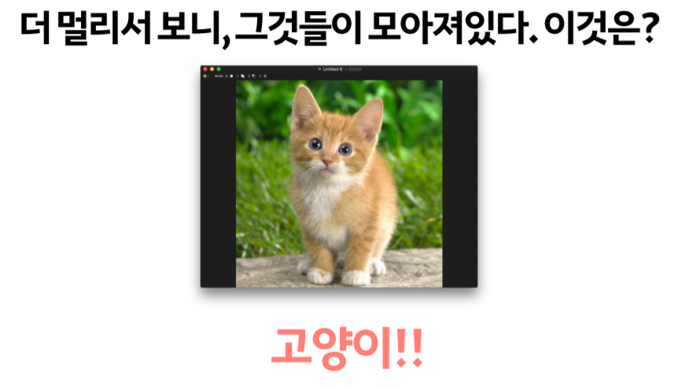

Slide 9
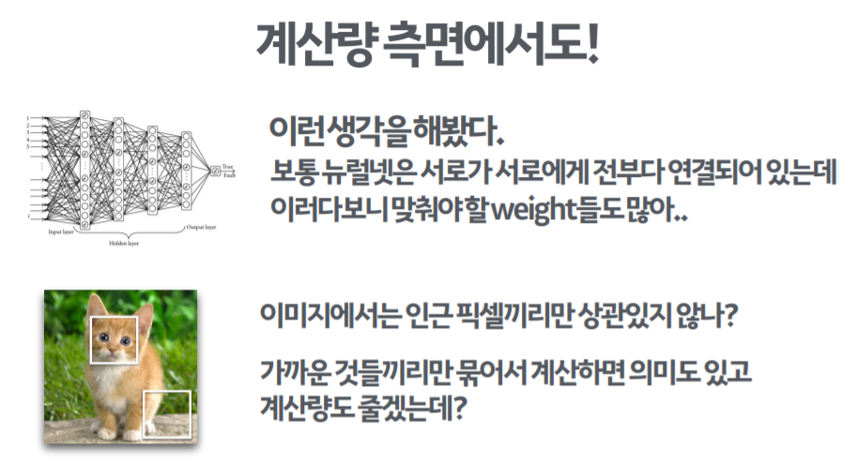
인접한 픽셀들끼리 높은 지역적 관계(local relationship)를 갖음
기존 NN은 local relationship을 고려하지 못함
이러한 단점을 극복한 것이 바로 CNN
Notes:
Local related

Slide 10


Fei-Fei Li & Andrej Karpathy & Justin Johnson
Lecture 7 - 22
27 Jan 2016
Fei-Fei Li & Andrej Karpathy & Justin Johnson Lecture 7 - 27 Jan 2016
Notes:
나눠서 입력 받는 것을 Conv 층이라고 부름
중간에 Pooling도 넣음
마지막에 FC을 구성해서 Labeling 함

Slide 11
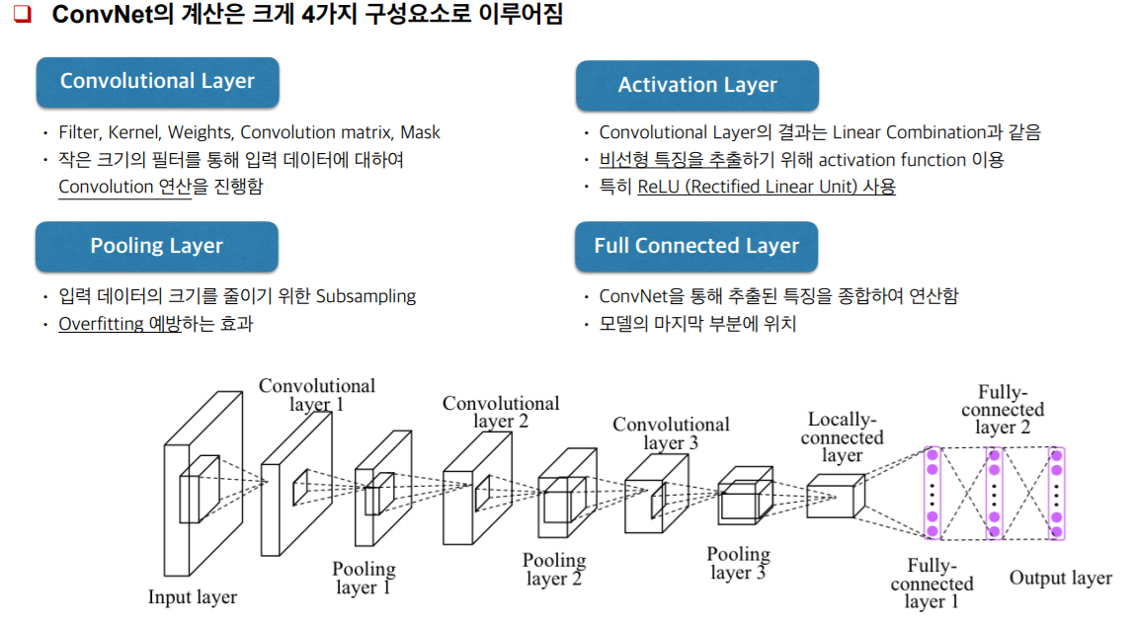

Slide 12
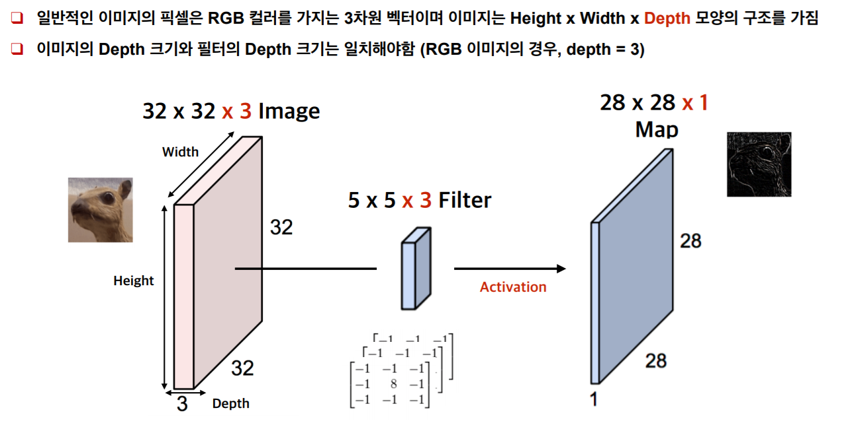

Slide 13
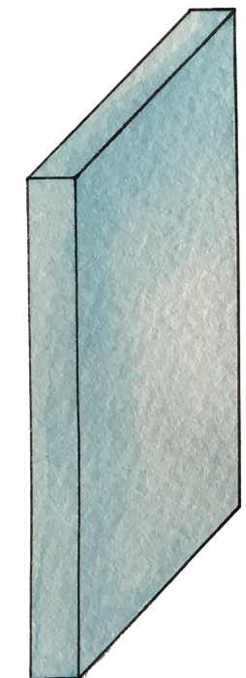

Start with an image (width x hight x depth)
32x32x3 image
Notes:
칼라이기 때문에 RGB(3) 높이

Slide 14
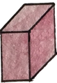
Let’s focus on a small area only
32x32x3 image

Slide 15
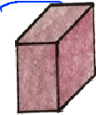
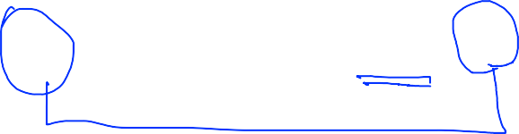
Let’s focus on a small area only (5x5x3)
32x32x3 image
5x5x3 filter
Notes:
필터의 사이즈는 보고 싶은 사이즈 맘대로

Slide 16
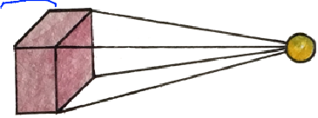
Get one number using the filter
one number!
32x32x3 image
Notes:
필터는 한 값을 만들어 냄

Slide 17
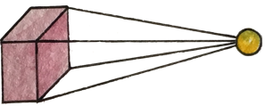
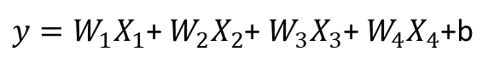
Get one number using the filter
$y=W_{1}X_{1}$+ $W_{2}X_{2}$+ $W_{3}X_{3}$+ $W_{4}X_{4}$+b
one number!
=Wx+b
=ReLU(Wx+b)
5x5x3 filter
32x32x3 image
Notes:
5*5*3개 만큼의 x가 있음 – 1개의 숫자로 만듬 (Wx_b를 이용해서)

Slide 18
Let’s look at other areas with the same filter (w)
one number!
32x32x3 image

Slide 19
Let’s look at other areas with the same filter (w)
one number!
32x32x3 image

Slide 20
Let’s look at other areas with the same filter (w)
one number!
32x32x3 image

Slide 21
Let’s look at other areas with the same filter (w)
one number!
32x32x3 image

Slide 22
Let’s look at other areas with the same filter (w)
one number!
How many numbers can we get?
32x32x3 image

Slide 23
A closer look at spatial dimensions:
7
7x7 input (spatially) assume 3x3 filter
7
Fei-Fei Li & Andrej Karpathy & Justin Johnson
27 Jan 2016
Fei-Fei Li & Andrej Karpathy & Justin Johnson Lecture 7 - 27 Jan 2016

Slide 24
A closer look at spatial dimensions:
7
7x7 input (spatially) assume 3x3 filter
7
Fei-Fei Li & Andrej Karpathy & Justin Johnson
27 Jan 2016
Fei-Fei Li & Andrej Karpathy & Justin Johnson Lecture 7 - 27 Jan 2016

Slide 25
A closer look at spatial dimensions:
7
7x7 input (spatially) assume 3x3 filter
7
Fei-Fei Li & Andrej Karpathy & Justin Johnson
27 Jan 2016
Fei-Fei Li & Andrej Karpathy & Justin Johnson Lecture 7 - 27 Jan 2016

Slide 26
A closer look at spatial dimensions:
7
7x7 input (spatially) assume 3x3 filter
7
Fei-Fei Li & Andrej Karpathy & Justin Johnson
27 Jan 2016
Fei-Fei Li & Andrej Karpathy & Justin Johnson Lecture 7 - 27 Jan 2016

Slide 27


A closer look at spatial dimensions:
7
7x7 input (spatially) assume 3x3 filter
=> 5x5 output
7
Fei-Fei Li & Andrej Karpathy & Justin Johnson
27 Jan 2016
Fei-Fei Li & Andrej Karpathy & Justin Johnson Lecture 7 - 27 Jan 2016

Slide 28
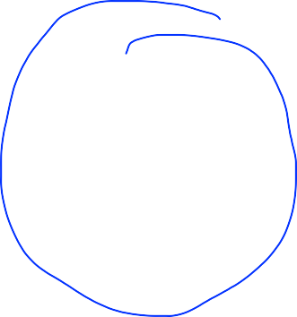
A closer look at spatial dimensions:
7
7x7 input (spatially) assume 3x3 filter applied with stride 2
7
Fei-Fei Li & Andrej Karpathy & Justin Johnson
27 Jan 2016
Fei-Fei Li & Andrej Karpathy & Justin Johnson Lecture 7 - 27 Jan 2016

Slide 29
A closer look at spatial dimensions:
7
7x7 input (spatially) assume 3x3 filter applied with stride 2
7
Fei-Fei Li & Andrej Karpathy & Justin Johnson
27 Jan 2016
Fei-Fei Li & Andrej Karpathy & Justin Johnson Lecture 7 - 27 Jan 2016

Slide 30
A closer look at spatial dimensions:
7
7x7 input (spatially) assume 3x3 filter applied with stride 2
=> 3x3 output!
7
Fei-Fei Li & Andrej Karpathy & Justin Johnson
27 Jan 2016
Fei-Fei Li & Andrej Karpathy & Justin Johnson Lecture 7 - 27 Jan 2016

Slide 31
N
Output size:
(N - F) / stride + 1
F
e.g. N = 7, F = 3:
stride 1 => (7 - 3)/1 + 1 = 5
stride 2 => (7 - 3)/2 + 1 = 3
stride 3 => (7 - 3)/3 + 1 = 2.33 :\
N
F
Fei-Fei Li & Andrej Karpathy & Justin Johnson
27 Jan 2016
Fei-Fei Li & Andrej Karpathy & Justin Johnson Lecture 7 - 27 Jan 2016
Notes:
Stride 3은 할 수가 없음
이미지가 자꾸 작아짐 – 정보를 잃어버림 – padding 개념을 사용

Slide 32
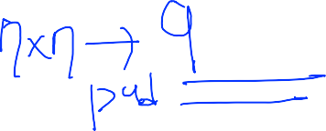

In practice: Common to zero pad the border
0 0 0 0 0 0
0
e.g. input 7x7
3x3 filter, applied with stride 1
pad with 1 pixel border => what is the output?
0
0
0
(recall:)
(N - F) / stride + 1
Fei-Fei Li & Andrej Karpathy & Justin Johnson
27 Jan 2016
Fei-Fei Li & Andrej Karpathy & Justin Johnson Lecture 7 - 27 Jan 2016
Notes:
1. 그림이 작아지는 것을 방지 2. 모서리임을 알려주기 위함 – padding을 사용

Slide 33
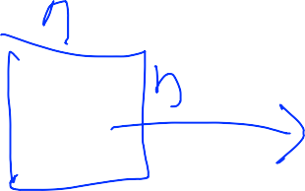
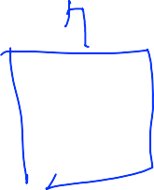
In practice: Common to zero pad the border
0 | 0 | 0 | 0 | 0 | 0
0
0
0
0
e.g. input 7x7
3x3 filter, applied with stride 1
pad with 1 pixel border => what is the output?
7x7 output!
Fei-Fei Li & Andrej Karpathy & Justin Johnson
27 Jan 2016
Fei-Fei Li & Andrej Karpathy & Justin Johnson Lecture 7 - 27 Jan 2016
Notes:
COV을 실행시켜도 같은 사이즈의 이미지가 나옴

Slide 34
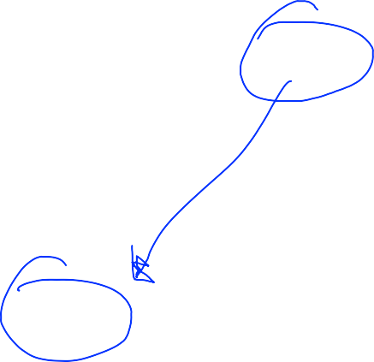
In practice: Common to zero pad the border
0 | 0 | 0 | 0 | 0 | 0
0
0
0
0
e.g. input 7x7
3x3 filter, applied with stride 1
pad with 1 pixel border => what is the output?
7x7 output!
in general, common to see CONV layers with stride 1, filters of size FxF, and zero-padding with (F-1)/2. (will preserve size spatially)
e.g. F = 3 => zero pad with 1
F = 5 => zero pad with 2 F = 7 => zero pad with 3
Fei-Fei Li & Andrej Karpathy & Justin Johnson
27 Jan 2016
Fei-Fei Li & Andrej Karpathy & Justin Johnson Lecture 7 - 27 Jan 2016

Slide 35
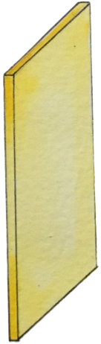
Swiping the entire image
5x5x3 filter 1
32x32x3 image

Slide 36
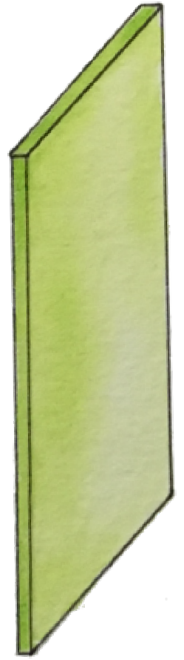



Swiping the entire image
5x5x3 filter 2
32x32x3 image

Slide 37
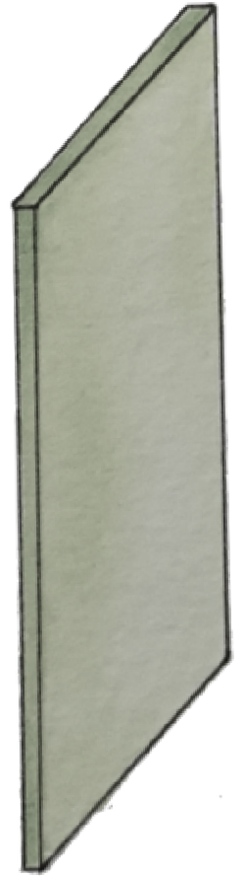
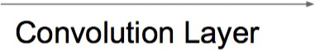
Swiping the entire image
6 filters (5x5x3)
activation maps (?, ?, ?)
(28,28,6)
32x32x3 image

Slide 38
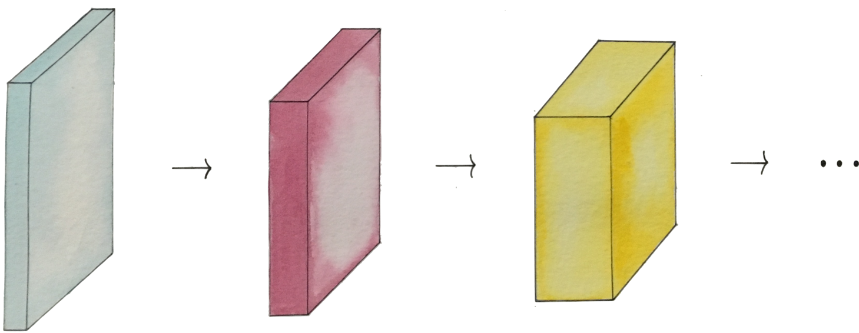
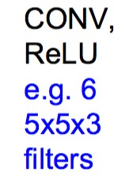
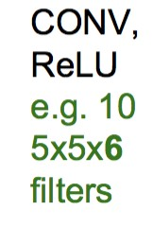
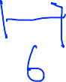
Convolution layers
32x32x3 image

Slide 39
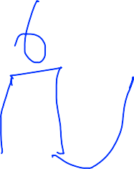
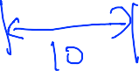
Convolution layers
32x32x3 image

Slide 40
Convolution layers
How many weight variables? How to set them?
32x32x3 image
Notes:
Weight의 개수는 얼마나 될 때
5*5*3개 + 5*5*6개
초기화후 학습을 함

Slide 41
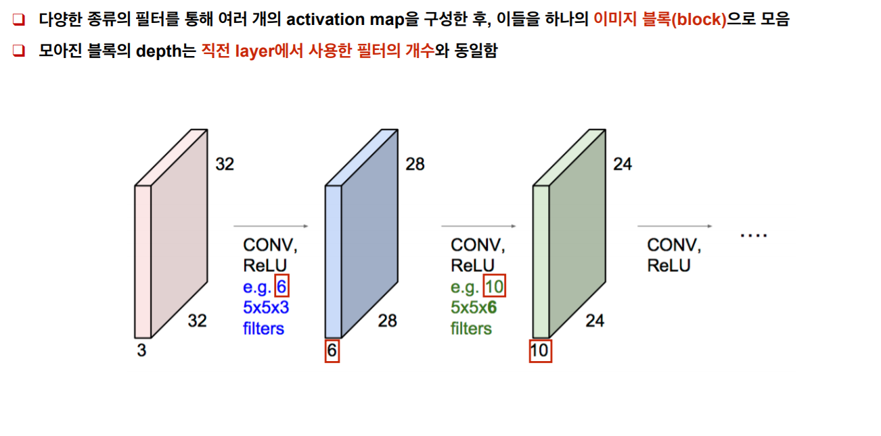

Slide 42
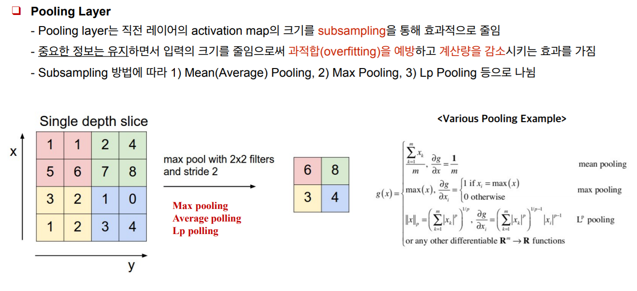

Slide 43
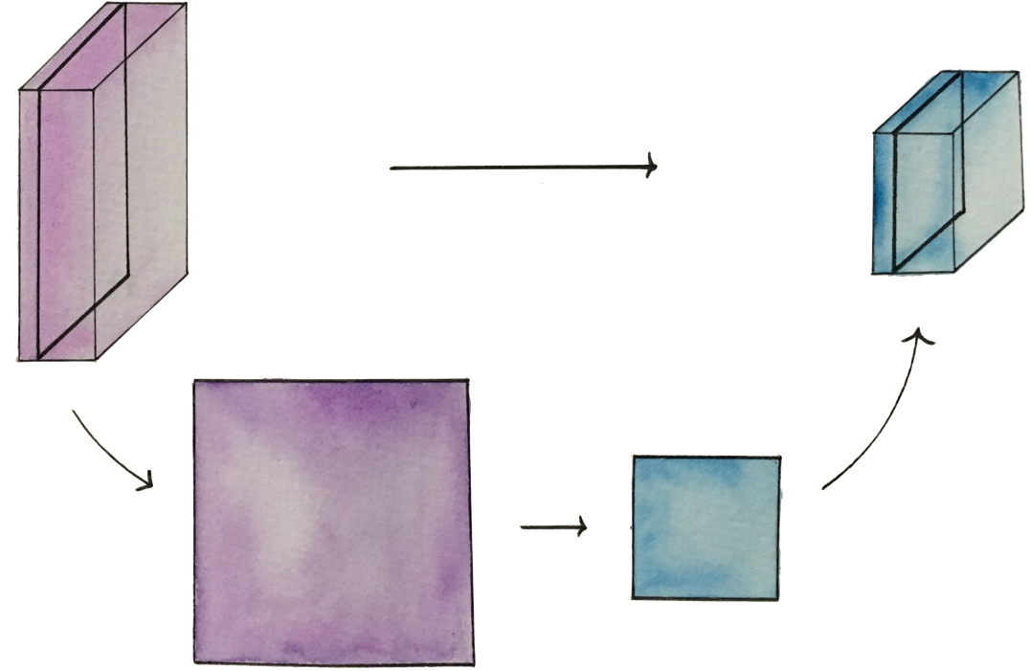


Pooling layer (sampling)
conv layer
resize (sampling)
Notes:
사이즈를 작게 만드는 것을 풀링이라고 함

Slide 44
MAX POOLING
Single depth slice
1 | 1 | 2 | 4
5 | 6 | 7 | 8
3 | 2 | 1 | 0
1 | 2 | 3 | 4
x
max pool with 2x2 filters and stride 2
6 | 8
3 | 4
y
Fei-Fei Li & Andrej Karpathy & Justin Johnson
Lecture 7 - 55
27 Jan 2016
Fei-Fei Li & Andrej Karpathy & Justin Johnson Lecture 7 - 27 Jan 2016

Slide 45
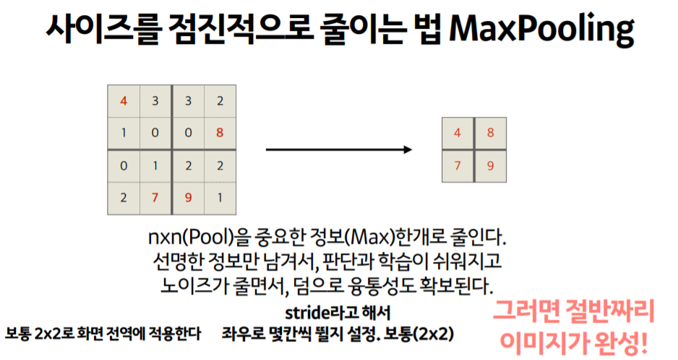

Slide 46
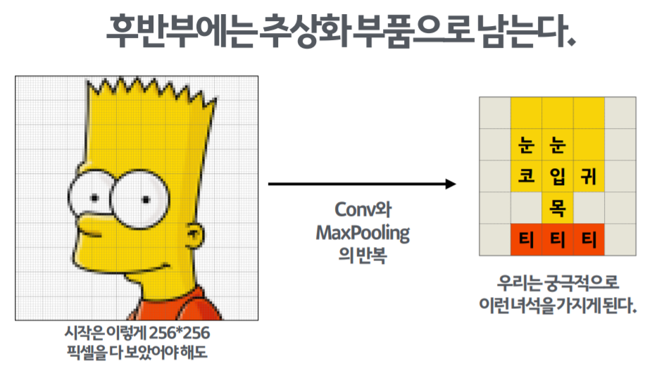

Slide 47

Fully Connected Layer (FC layer)
- Contains neurons that connect to the entire input volume, as in ordinary Neural Networks
Fei-Fei Li & Andrej Karpathy & Justin Johnson
27 Jan 2016
Fei-Fei Li & Andrej Karpathy & Justin Johnson Lecture 7 - 27 Jan 2016
Notes:
어떤식으로 쌓을지는 자유
마지막에 FC를 이용하여 Labeling

Slide 48
[ConvNetJS demo: training on CIFAR-10]
http://cs.stanford.edu/people/karpathy/convnetjs/demo/cifar10.html
[ 과정 시각화 ]
https://youtu.be/f0t-OCG79-U
Fei-Fei Li & Andrej Karpathy & Justin Johnson
27 Jan 2016
Fei-Fei Li & Andrej Karpathy & Justin Johnson Lecture 7 - 27 Jan 2016

Slide 49
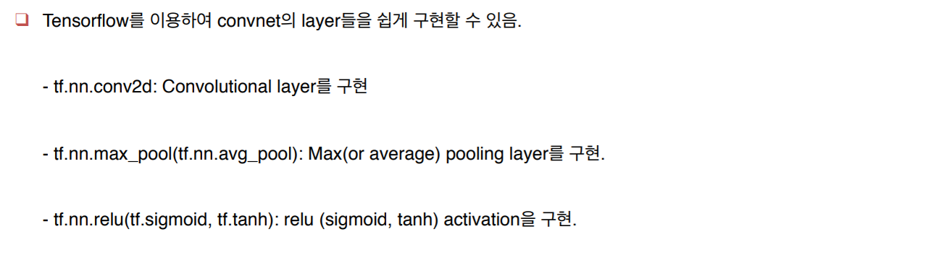

Slide 50
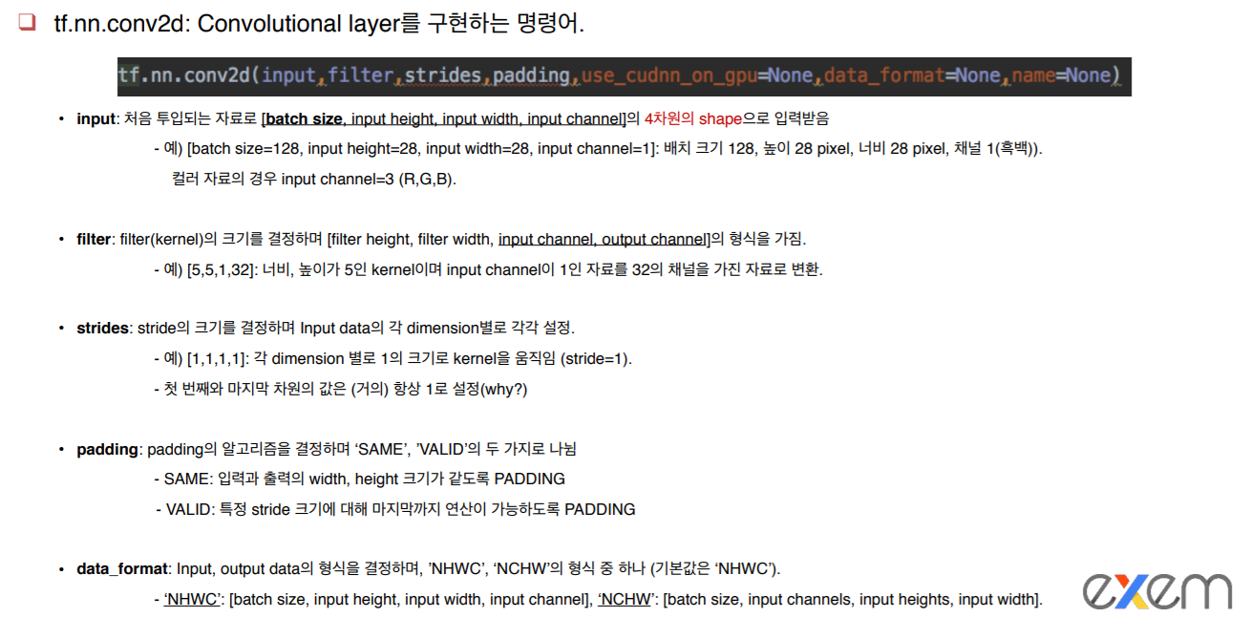

Slide 51
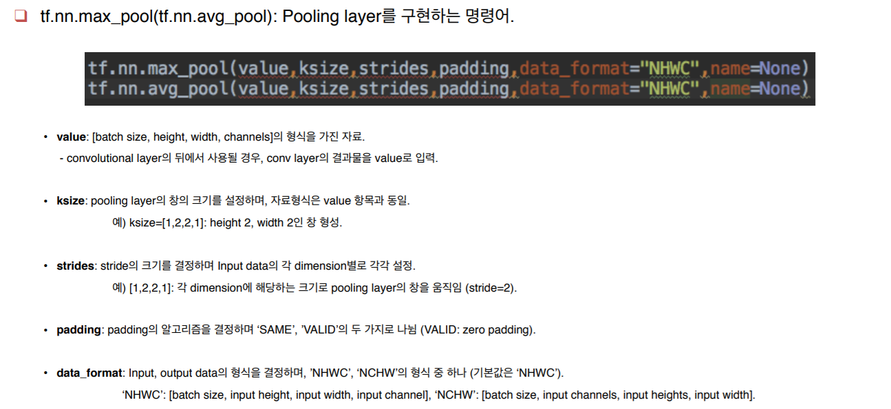

Slide 52
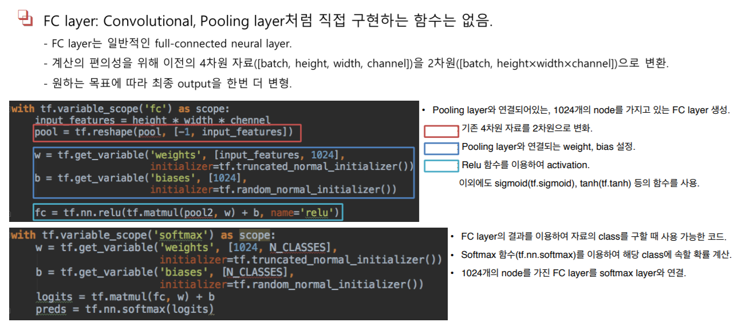

Slide 54
Lecture
CNN case study

Slide 55
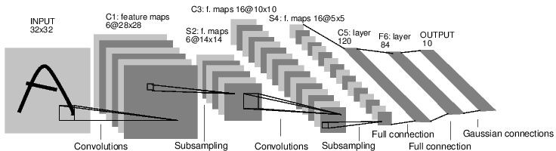

Case Study: LeNet-5
[LeCun et al., 1998]
Conv filters were 5x5, applied at stride 1 * 6
Subsampling (Pooling) layers were 2x2 applied at stride 2
i.e. architecture is [CONV-POOL-CONV-POOL-CONV-FC]
Notes:
LeCun이 처음 제시한 CNN 구조

Slide 56
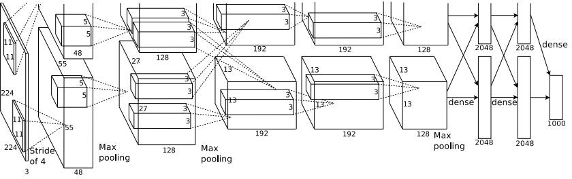
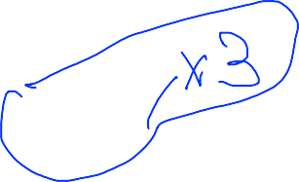

Case Study: AlexNet
[Krizhevsky et al. 2012]
Input: 227x227x3 images
First layer (CONV1): 96 11x11 filters applied at stride 4
=>
Output volume [55x55x96]
Parameters: (11*11*3)*96 = 35K
Fei-Fei Li & Andrej Karpathy & Justin Johnson
Lecture 7 - 63
27 Jan 2016
Fei-Fei Li & Andrej Karpathy & Justin Johnson Lecture 7 - 27 Jan 2016
Notes:
이미지넷에서 1등을 하면서 많은 관심을 끔
35K의 weight parameter가 필요

Slide 57
Case Study: AlexNet
[Krizhevsky et al. 2012]
Input: 227x227x3 images After CONV1: 55x55x96
Second layer (POOL1): 3x3 filters applied at stride 2 Output volume: 27x27x96
Parameters: 0!
Fei-Fei Li & Andrej Karpathy & Justin Johnson
27 Jan 2016
Fei-Fei Li & Andrej Karpathy & Justin Johnson Lecture 7 - 27 Jan 2016

Slide 58
Case Study: AlexNet
[Krizhevsky et al. 2012]
Input: 227x227x3 images After CONV1: 55x55x96 After POOL1: 27x27x96
...
Fei-Fei Li & Andrej Karpathy & Justin Johnson
27 Jan 2016
Fei-Fei Li & Andrej Karpathy & Justin Johnson Lecture 7 - 27 Jan 2016

Slide 59
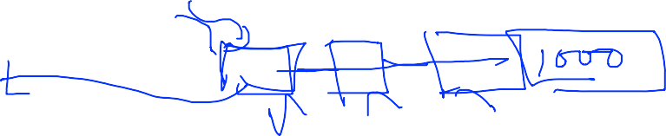
Case Study: AlexNet
[Krizhevsky et al. 2012]
Full (simplified) AlexNet architecture: [227x227x3] INPUT
[55x55x96] CONV1: 96 11x11 filters at stride 4, pad 0
[27x27x96] MAX POOL1: 3x3 filters at stride 2 [27x27x96] NORM1: Normalization layer
[27x27x256] CONV2: 256 5x5 filters at stride 1, pad 2
[13x13x256] MAX POOL2: 3x3 filters at stride 2 [13x13x256] NORM2: Normalization layer [13x13x384] CONV3: 384 3x3 filters at stride 1, pad 1 [13x13x384] CONV4: 384 3x3 filters at stride 1, pad 1 [13x13x256] CONV5: 256 3x3 filters at stride 1, pad 1 [6x6x256] MAX POOL3: 3x3 filters at stride 2
[4096] FC6: 4096 neurons
[4096] FC7: 4096 neurons
[1000] FC8: 1000 neurons (class scores)
Fei-Fei Li & Andrej Karpathy & Justin Johnson
27 Jan 2016
Fei-Fei Li & Andrej Karpathy & Justin Johnson Lecture 7 - 27 Jan 2016
Notes:
NORM 레이어는 최근에 많이 사용하지 않음
이미지넷은 1000개의 레이블 중에 맞추는 것

Slide 60
Case Study: AlexNet
[Krizhevsky et al. 2012]
Full (simplified) AlexNet architecture: [227x227x3] INPUT
[55x55x96] CONV1: 96 11x11 filters at stride 4, pad 0
[27x27x96] MAX POOL1: 3x3 filters at stride 2 [27x27x96] NORM1: Normalization layer
[27x27x256] CONV2: 256 5x5 filters at stride 1, pad 2
[13x13x256] MAX POOL2: 3x3 filters at stride 2 [13x13x256] NORM2: Normalization layer [13x13x384] CONV3: 384 3x3 filters at stride 1, pad 1 [13x13x384] CONV4: 384 3x3 filters at stride 1, pad 1 [13x13x256] CONV5: 256 3x3 filters at stride 1, pad 1 [6x6x256] MAX POOL3: 3x3 filters at stride 2
[4096] FC6: 4096 neurons
[4096] FC7: 4096 neurons
[1000] FC8: 1000 neurons (class scores)
Details/Retrospectives:
first use of ReLU
used Norm layers (not common anymore)
heavy data augmentation
dropout 0.5
batch size 128
SGD Momentum 0.9
Learning rate 1e-2, reduced by 10 manually when val accuracy plateaus
L2 weight decay 5e-4
- 7 CNN ensemble: 18.2% -> 15.4%
Fei-Fei Li & Andrej Karpathy & Justin Johnson
27 Jan 2016
Fei-Fei Li & Andrej Karpathy & Justin Johnson Lecture 7 - 27 Jan 2016

Slide 61
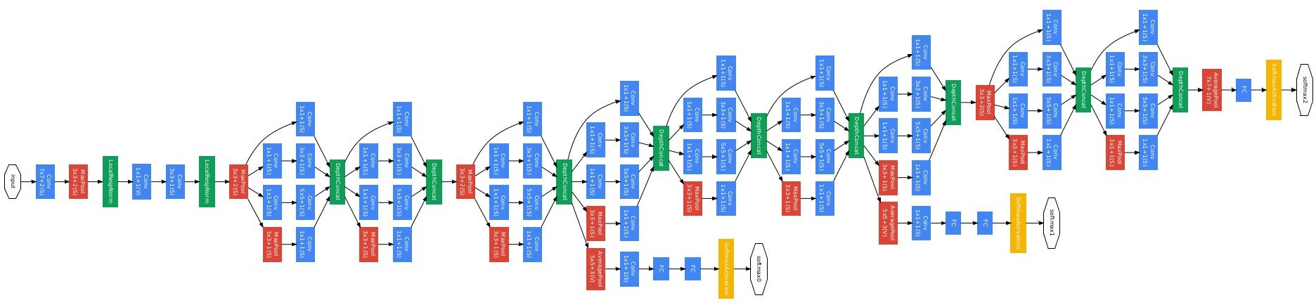
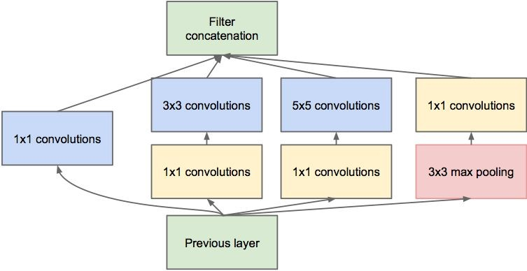
Case Study: GoogLeNet
[Szegedy et al., 2014]
Inception module
ILSVRC 2014 winner (6.7% top 5 error)
Fei-Fei Li & Andrej Karpathy & Justin Johnson
Lecture 7 - 75
27 Jan 2016
Fei-Fei Li & Andrej Karpathy & Justin Johnson Lecture 7 - 27 Jan 2016
Notes:
레고 섞듯이 재밌는 구조. 2014년에 우승을 한 구조

Slide 62
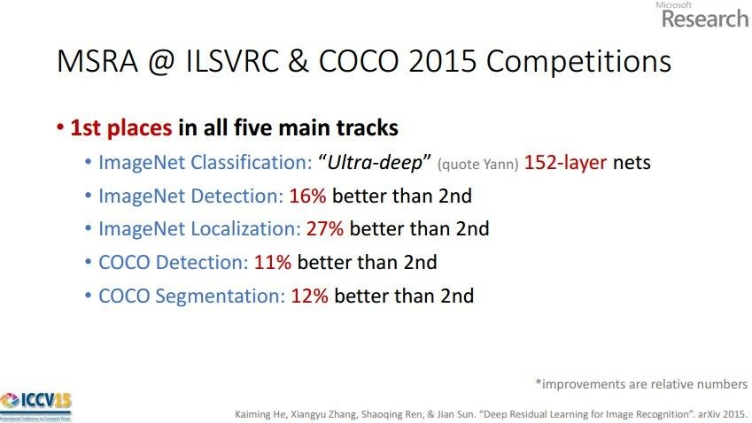
Case Study: ResNet
[He et al., 2015]
ILSVRC 2015 winner (3.6% top 5 error)
Slide from Kaiming He’s recent presentation https://www.youtube.com/watch?v=1PGLj-uKT1w
Fei-Fei Li & Andrej Karpathy & Justin Johnson
Lecture 7 - 77
27 Jan 2016
Fei-Fei Li & Andrej Karpathy & Justin Johnson Lecture 7 - 27 Jan 2016
Notes:
최강자. 사람을 뛰어 넘음
이미지넷뿐 아니라 많은 대회를 다 1등함

Slide 63

Case Study: ResNet
[He et al., 2015]
ILSVRC 2015 winner (3.6% top 5 error)
2-3 weeks of training on 8 GPU machine
at runtime: faster than a VGGNet! (even though it has 8x more layers)
(slide from Kaiming He’s recent presentation)
Fei-Fei Li & Andrej Karpathy & Justin Johnson
27 Jan 2016
Fei-Fei Li & Andrej Karpathy & Justin Johnson Lecture 7 - 27 Jan 2016
Notes:
152개의 레이어를 사용. 학습이 어렵지 않을까?
Fastforward 개념을 사용해서 해결

Slide 64

Case Study: ResNet
224x224x3
spatial dimension
only 56x56!
[He et al., 2015]
Fei-Fei Li & Andrej Karpathy & Justin Johnson
27 Jan 2016
Fei-Fei Li & Andrej Karpathy & Justin Johnson Lecture 7 - 27 Jan 2016
Notes:
중간에 값을 훅 뛰어넘음

Slide 65


Case Study: ResNet
[He et al., 2015]
Fei-Fei Li & Andrej Karpathy & Justin Johnson
27 Jan 2016
Fei-Fei Li & Andrej Karpathy & Justin Johnson Lecture 7 - 27 Jan 2016
Notes:
레이어가 깊지만 실제 학습하는 입장에서 그리 깊지는 않음
왜 잘되는지는 사실 잘 모름

Slide 66

Case Study: ResNet
[He et al., 2015]
(this trick is also used in GoogLeNet)
Fei-Fei Li & Andrej Karpathy & Justin Johnson
Lecture 7 - 85
27 Jan 2016
Fei-Fei Li & Andrej Karpathy & Justin Johnson Lecture 7 - 27 Jan 2016
Notes:
다르지만 유사한 아이디어

Slide 67

Convolutional Neural Networks for Sentence Classification [Yoon Kim, 2014]
Notes:
한국의 윤김 박사가 텍스트를 CNN으로 처리해봄

Slide 68



Case Study Bonus: DeepMind’s AlphaGo
Fei-Fei Li & Andrej Karpathy & Justin Johnson
27 Jan 2016
Fei-Fei Li & Andrej Karpathy & Justin Johnson Lecture 7 - 27 Jan 2016

Slide 69


policy network:
[19x19x48] Input
CONV1: 192 5x5 filters , stride 1, pad 2 => [19x19x192] CONV2..12: 192 3x3 filters, stride 1, pad 1 => [19x19x192]
CONV: 1 1x1 filter, stride 1, pad 0 => [19x19] (probability map of promising moves)
Fei-Fei Li & Andrej Karpathy & Justin Johnson
27 Jan 2016
Fei-Fei Li & Andrej Karpathy & Justin Johnson Lecture 7 - 27 Jan 2016
Notes:
알파고 네이처 논문을 보면 대충 무슨 뜻인지 알겠지요?

